Slide 1
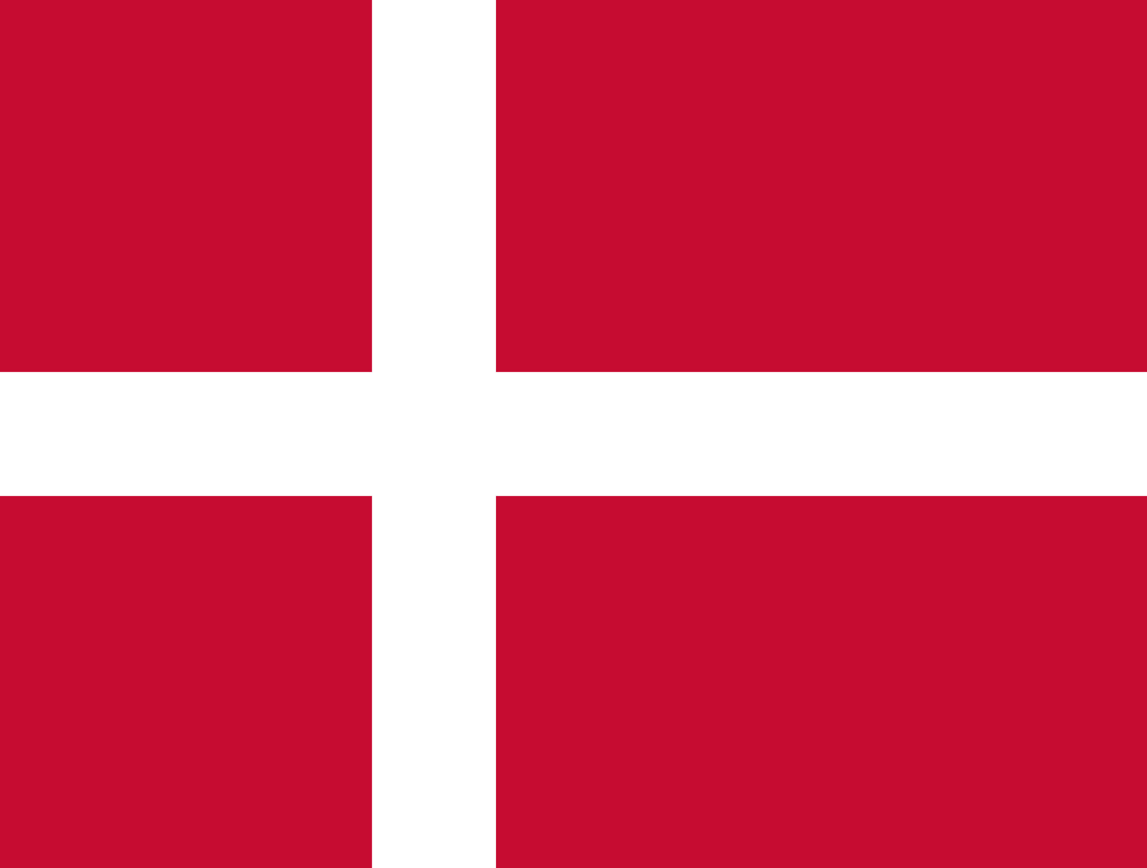
Denmark
Interesting facts about
By:Rosca Dorin TI-216
Teacher:Crudu Corina

Slide 2
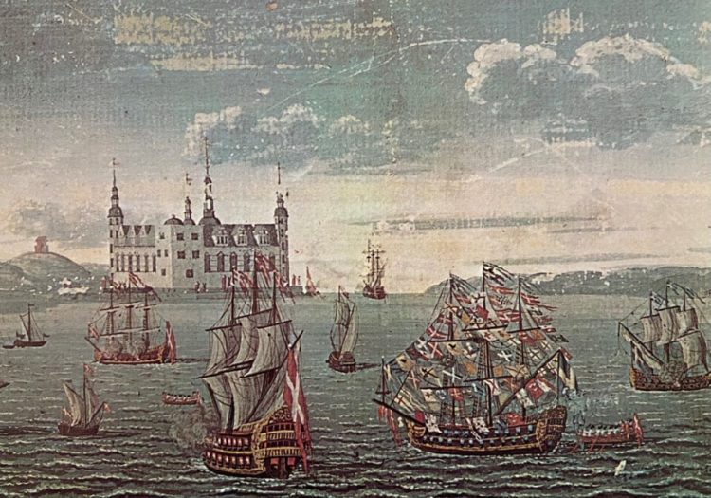
History
The unified Kingdom of Denmark became a skilled maritime power in the 8th century in the struggle for control of the Baltic Sea. In 1397, it formed the Kalmar Union with Norway and Sweden until the latter separated in 1523; the remaining Kingdom of Denmark-Norway existed until 1814. Beginning in the 17th century, several wars with the Swedish Empire resulted in the cessation of territories. After the Napoleonic Wars, Norway was merged into Sweden, while Denmark retained the Faroe Islands, Greenland and Iceland.

Slide 3
One of the happiest countries in the world
01
The oldest flag in the world
02
Interesting facts about Denmark
More than 50% of Copenhageners cycle to and from work every day
03
04
The Danish alphabet has 3 additional letters: Æ, Ø, and Å
Denmark has 444 islands, but only 76 of them are inhabited
05
Denmark has been named the world's happiest country on numerous occasions, and remains to be in the very top of the UN World Happiness Report.
First acknowledged in 1219, the Danish flag "Dannebrog" remains the oldest state flag in the world still in use by an independent nation.
Copenhageners cycle an average of 3km every day and this adds up to people cycling 35 times around the world every day in Copenhagen! The bicycle is clearly the preferred mode of transport in Denmark: 4 out of 10 Danes own a car but 9 out of 10 Danes own a bike.
The Danish language is said to be one of the most difficult ones to learn due to a bunch of silent letters and complex pronunciation.
This means that there are plenty of opportunities for everyone to go on an island getaway!

Slide 4
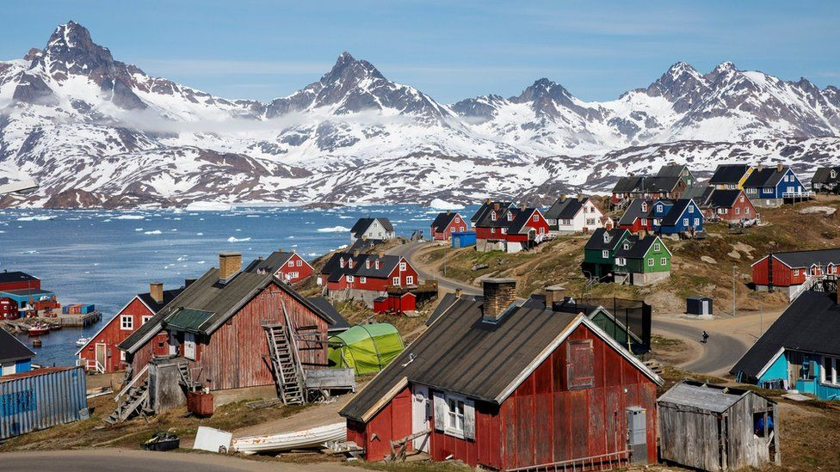
Greenland
Greenland is an autonomous territory within the Kingdom of Denmark. Although geographically a part of the North American continent, Greenland has been politically and culturally associated with Europe (especially Norway and Denmark, colonial countries), and it has been more than a thousand years since 986. Most of its residents are Inuit, whose ancestors migrated from Alaska to northern Canada, and gradually settled on the island in the 13th century.

Slide 5
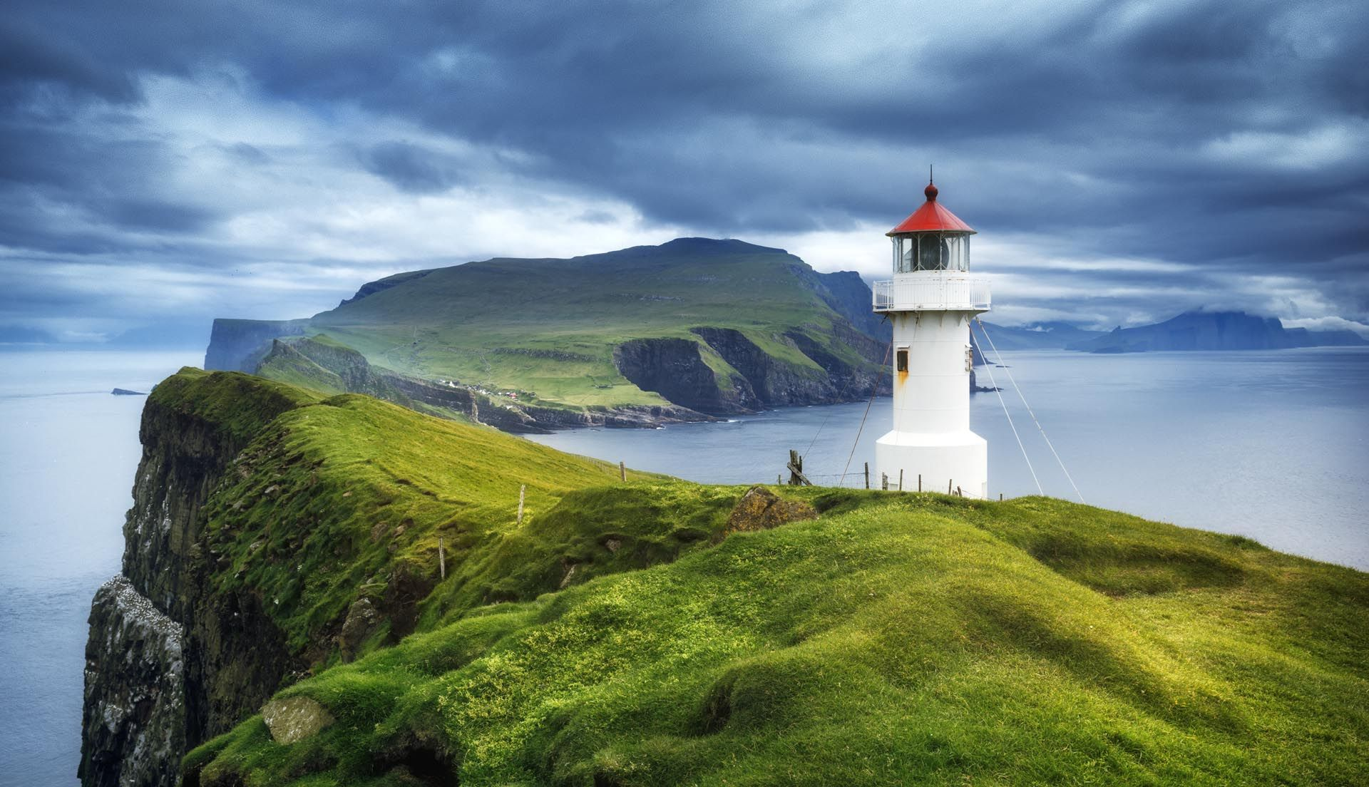
The Faroe
The Faroe or the Faroe Islands are a Islands in the Atlantic Ocean, north-northwest of Scotland, approximately between Norway and Iceland. Like Greenland, it is an autonomous territory of the Kingdom of Denmark. As of June 2021, the total area of ​​these islands is approximately 1,400 square kilometers (540 square miles) with a population of 53,358. As part of the Kingdom of Denmark, the Faroe Islands have been autonomous since 1948. Except for military defense, police, justice, currency and foreign affairs, control most of the area. Since the Faroe Islands and Denmark do not belong to the same customs territory, the Faroe Islands has an independent trade policy and can establish trade agreements with other countries. The Faroe Islands and Iceland have signed an extensive bilateral free trade agreement called the Hoyvik Agreement.

Slide 6
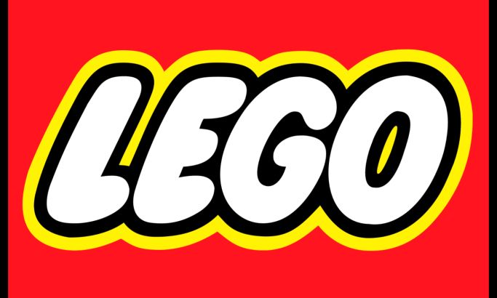
Danish Lego company
Probably the most popular thing with whom people associates Denmark is Lego company .It was foundated by a dutch businessman Kjeld Kirk Kristiansen
The story of the LEGO Group spans four generations of family ownership. It all began back in 1932, when carpenter Ole Kirk Kristiansen founded the company. He called it LEGO from the Danish words ‘leg godt’ which means ‘play well” and the company grew from humble beginnings to become the LEGO Group.
The LEGO Group owner family is actively engaged in the LEGO Foundation board of directors and has chosen to transfer ownership of 25% of the Group to the LEGO Foundation. This is how they fund their activities.
Today, Ole Kirk Kristiansen’s grandson, Kjeld Kirk Kristiansen, is the owner of the LEGO Group and the deputy chairman of the LEGO Foundation board. Kjeld Kirk Kristiansen’s son, Thomas Kirk Kristiansen, is chairman of the LEGO Foundation board.

